Slide 1

Sign Language Detection using Hand Landmark-based Approach
By: Kotha Bharath Reddy (E22CSEU1103), Pratheek Reddy (E22CSEU1088), Jitendra (E22CSEU1091)

Slide 2
Abstract
Our system recognizes American Sign Language gestures in real-time.
Deep learning models (CNN, LSTM) classify static and sequential gestures.
MediaPipe extracts hand landmarks, feeding models that translate gestures.
This aids communication for hearing-impaired users by converting gestures to speech and text.

Slide 3
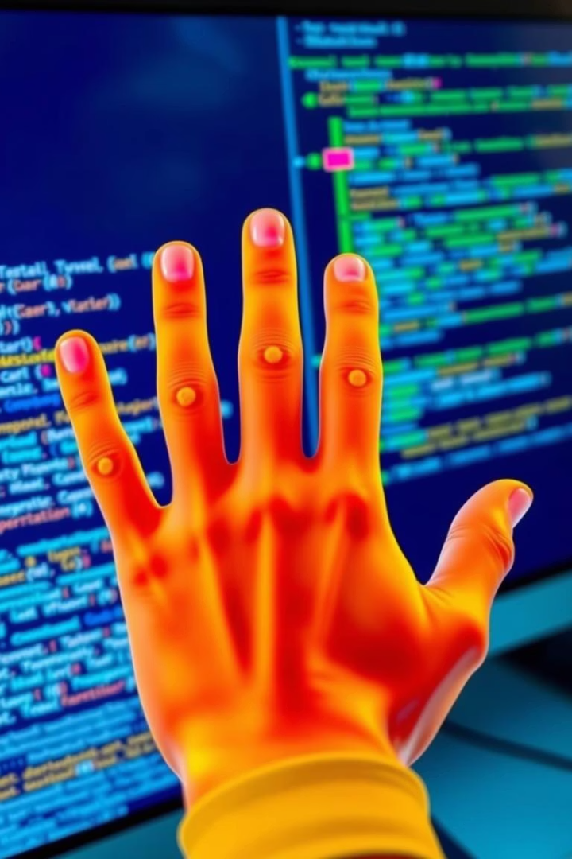
Project Objectives
Gesture Recognition
Detect ASL alphabets and numbers using hand landmarks.
Technology Integration
Utilize MediaPipe and OpenCV for precise landmark detection.
Model Training
Train CNN and LSTM architectures for accurate classification.
Real-time Conversion
Convert recognized signs into text and speech immediately.

Slide 4
System Architecture
Input Capture
Webcam captures hand gestures continuously.
Landmark Extraction
MediaPipe extracts 3D hand landmark coordinates.
Feature Vector
Calculate angles and distances between landmarks.
Model Prediction
CNN and LSTM classify gestures from features.
Output
Display text and generate speech via pyttsx3.

Slide 5





Technologies Used
MediaPipe
OpenCV
TensorFlow/Keras
Tkinter
Hand landmark detection framework.
Image processing and webcam interface.
Deep learning model development and training.
Graphical user interface framework.
pyttsx3
Text-to-speech system for audio output.

Slide 6
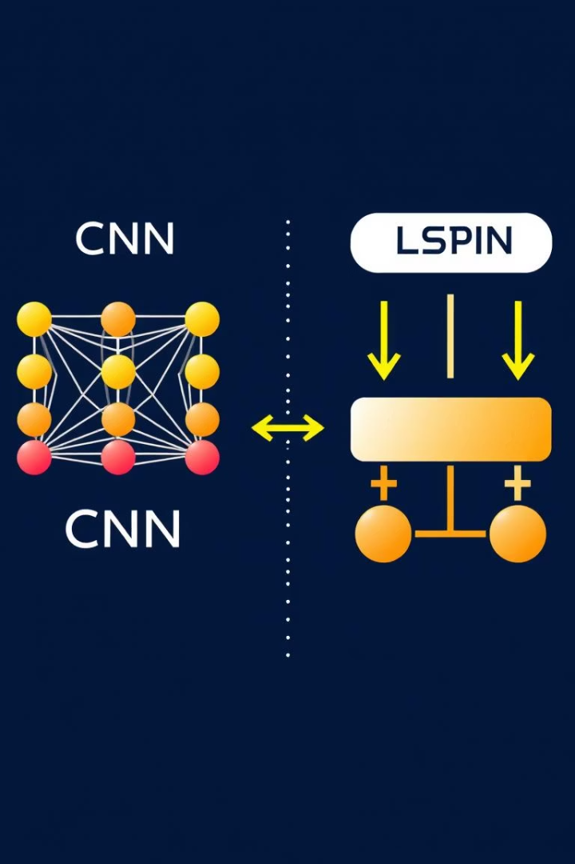
Model Details
CNN Model
Trained on static ASL gestures for spatial pattern recognition.
LSTM Model
Handles temporal sequences capturing gesture movements over time.
Performance Metrics
Accuracy
Precision
Recall
F1-Score
User Independence
Models fine-tuned to generalize across diverse users and conditions.

Slide 7
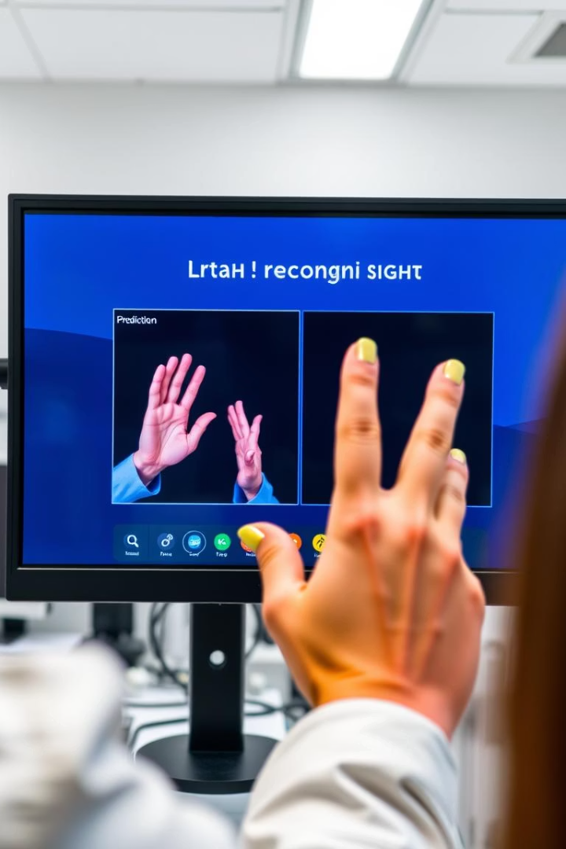
Experimental Results
High Accuracy
Achieved over 90% accuracy across test conditions.
Robustness
Functions reliably under varied lighting and user hand sizes.
Real-time
Minimal latency for immediate user feedback from webcam input.
Audio Feedback
Voice output using pyttsx3 ensures accessibility and ease of use.

Slide 8
Team Contribution: Kotha Bharath Reddy
Project Lead
Deep Learning Developer
Integration
Led project development and coordinated team efforts.
Designed and trained CNN and LSTM models.
Implemented gesture-to-speech module and evaluated system accuracy.

Slide 9
Team Contribution: Pratheek Reddy
Computer Vision Engineer
Feature Engineer
Captured and annotated precise hand gesture datasets.
Preprocessed images and extracted landmarks using MediaPipe.

Slide 10
Team Contribution: Jitendra
UI/UX Developer
System Integrator
Quality Assurance
Created user-friendly GUI with Tkinter framework.
Integrated classifier and speech synthesis components.
Conducted cross-platform testing and finalized documentation.

Slide 11
Conclusion
Innovative Approach
Reliable Performance
Combined MediaPipe, CNN, and LSTM for real-time sign language detection.
Achieved high accuracy with robust user-independent models.
User Accessibility
Team Synergy
Integrated text and speech output for enhanced user interaction.
Collaborative effort across deep learning, vision, and UI development.

